Slide 1
Seizing Opportunities in Tech
Practical advice from Facebook’s engineering lead

Slide 2
Director of Training
Kate Farrow
kate@everywoman.com

Slide 3
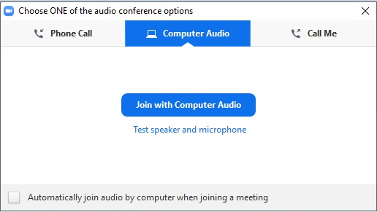
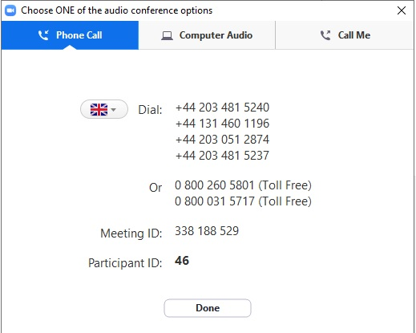
Dialing in
You will not need a microphone
To use headphones:
click ‘Call Using Computer’
To dial in and listen via phone:
CLICK ‘Phone Call’
and follow the instructions on screen

Slide 4
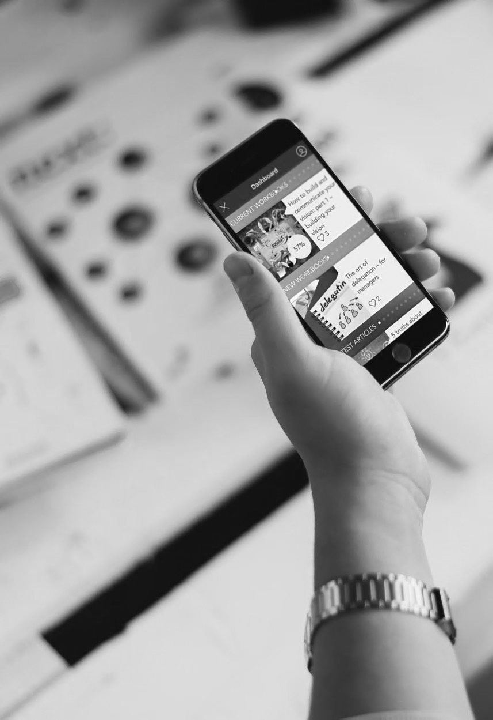
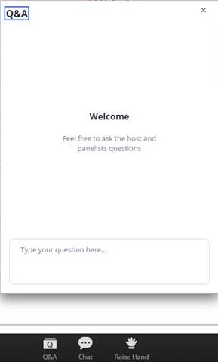
Questions
Send a question on the webinar

Slide 5
Lila Papadoperaki
Engineering Manager, Facebook

Slide 6
A winding path

Slide 7
Project description and requirements
Open heart and open mind
Curiosity
Love thyself

Slide 8
Initial iterations
Teaching
Coding
Focus on users
Focus on process
Focus on team

Slide 9
Insights

Slide 10
Roadblocks

Slide 11
Milestones

Slide 12
Stakeholder impact

Slide 13
User impact
Empower
Role model
Community

Slide 14
Retrospective
Work on your own terms
Optimize for learning
Be the impostor

Slide 15
Questions?

Slide 16
2020 everywoman in Tech Forum
the future of tech leadership
everywoman.com/facebook

Slide 17
Thank you

