Slide 1
Women who lead
How to lead as a woman in a
Male dominated environment

Slide 2
Director of Training
Kate Farrow
kate@everywoman.com

Slide 3
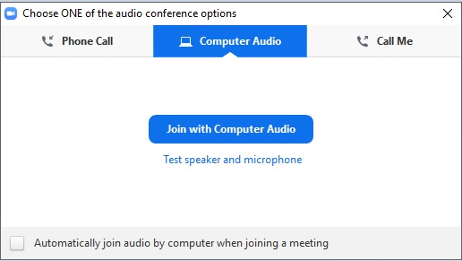
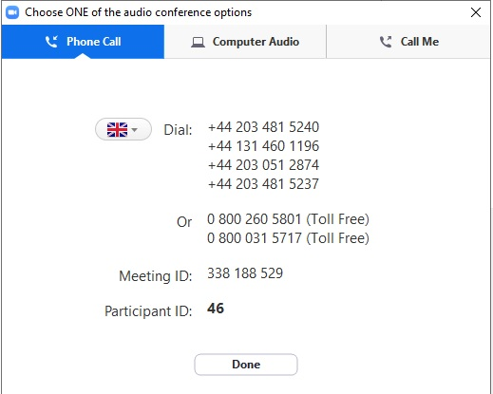
Dialling in
You will not need a microphone
To use headphones:
click ‘Call Using Computer’
To dial in and listen via phone:
CLICK ‘Phone Call’
and follow the instructions on screen

Slide 4
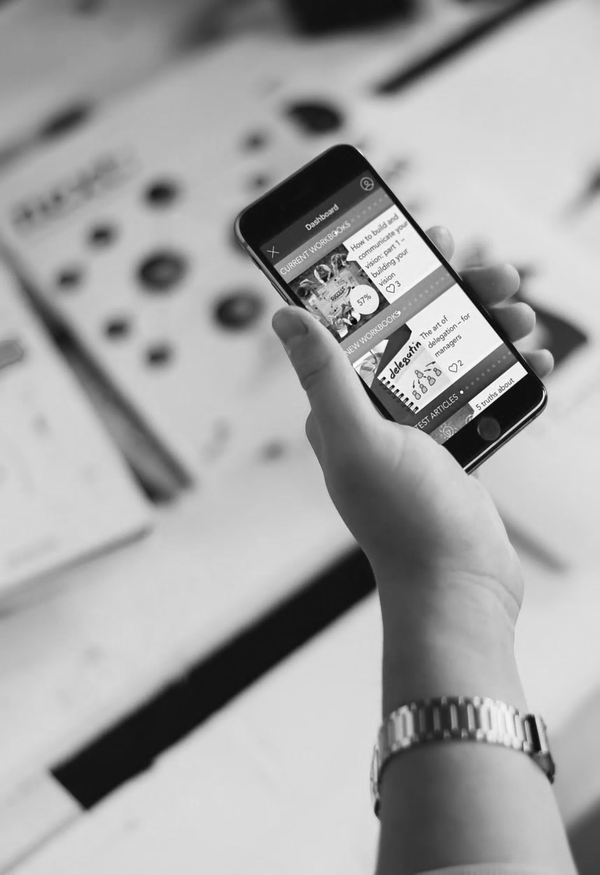
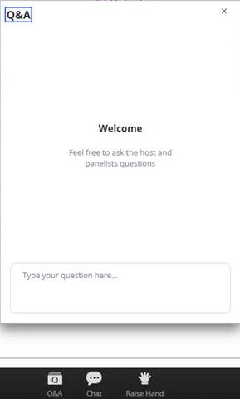
Questions
Send a question on the webinar

Slide 5
Jodi Goldman
Personal Impact Specialist
www.jodigoldman.co.uk

Slide 6
Poll: Have you ever thought / said ANY of the following:
Men are like little boys
Men don’t listen
Men interrupt / cut women off all the time
Men can’t do more than one thing at a time
Men can’t find stuff that’s right in front of them
Men don’t remember stuff you tell them
Men are so…
A - Yes
B - No

Slide 7
When it comes to gender equality…
EQUAL
Not the
SAME

Slide 8
Masculine / Male
Feminine / Female
Competence / competition
Safety / protect
Results
Independence
Facts
Fix / push
Single Focus / hunt
Need / needed
Provide
Connection / communication
Dream / improve
Process
Together
Feelings
Allow / pull
Diffuse awareness / gather
Want / wanted
Receive

Slide 9
What this means practically…
Get the full attention of men before speaking: “is this a good time / when would be a good time?” or use name, then pause
Give time to answer without interrupting
Feed forward (instead of criticizing) eg. I appreciate x, one thing that would make it even better is…
Work with, don’t compete with - “team”
Give points!
Ask for help / ask for what you need
Focus on one thing at a time
Get clear on the problem / point (or say if there isn’t one)

Slide 10
Poll true or false:
Women have to work harder than men to be successful
When men are assertive its good, when women are assertive they are seen as aggressive
Women have to act like the men to be taken seriously
A - True
B - False

Slide 11
What you focus on grows

Slide 12
Being assertive:
Having confidence in your needs/wants/thoughts and being confident to share them;
…while also being open to the needs/wants/thoughts of others;
…with a view to create a win-win outcome.

Slide 13
Aggressive | Assertive
Passive aggressive | Accommodating
- Confidence +
+ Openness -

Slide 14
Balancing the feminine and masculine energy inside you
Embrace your feminine power
Having it all, doesn’t mean doing it all yourself!
Consciously lean back, intentionally lean forward

Slide 15
Questions

Slide 16
Thank you

