Slide 1
Change-makers:
Are you just weird enough?
19th August 2021
Notes:
When we are trying to make change happen in an organisation it can be useful to pay attention to how ‘weird’ we are coming across to our colleagues. In the 1970s, Jonno Hannafin came up with the concept of The Perceived Weirdness Index. The essence of the idea is that if we are too different (too weird) to the culture we are trying to change then it’s likely we will be rejected, but we have to be weird enough to challenge the status quo. If you are trying to lead change in your organisation or community, there is a line to tread between being so radical that you get spat out, and blending into the norm so much that you don’t make anything happen. How do successful change-makers walk that line?

Slide 2
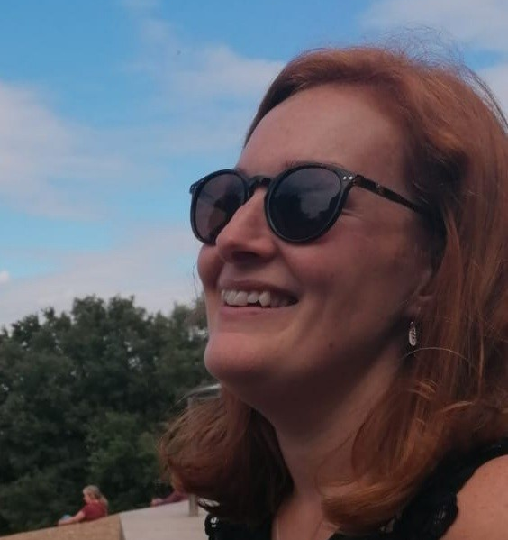
Eileen Evans
Head of Partnerships
eileen@everywoman.com

Slide 3
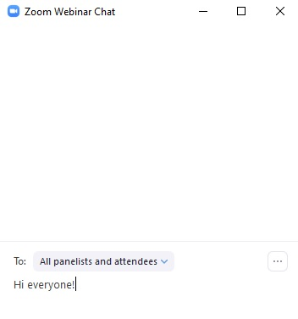
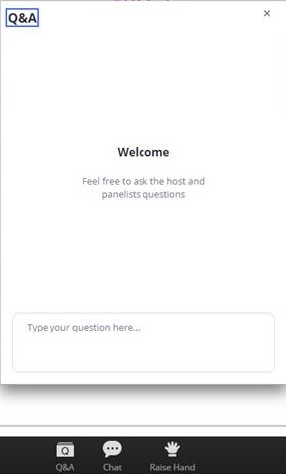
Questions and Chat

Slide 4
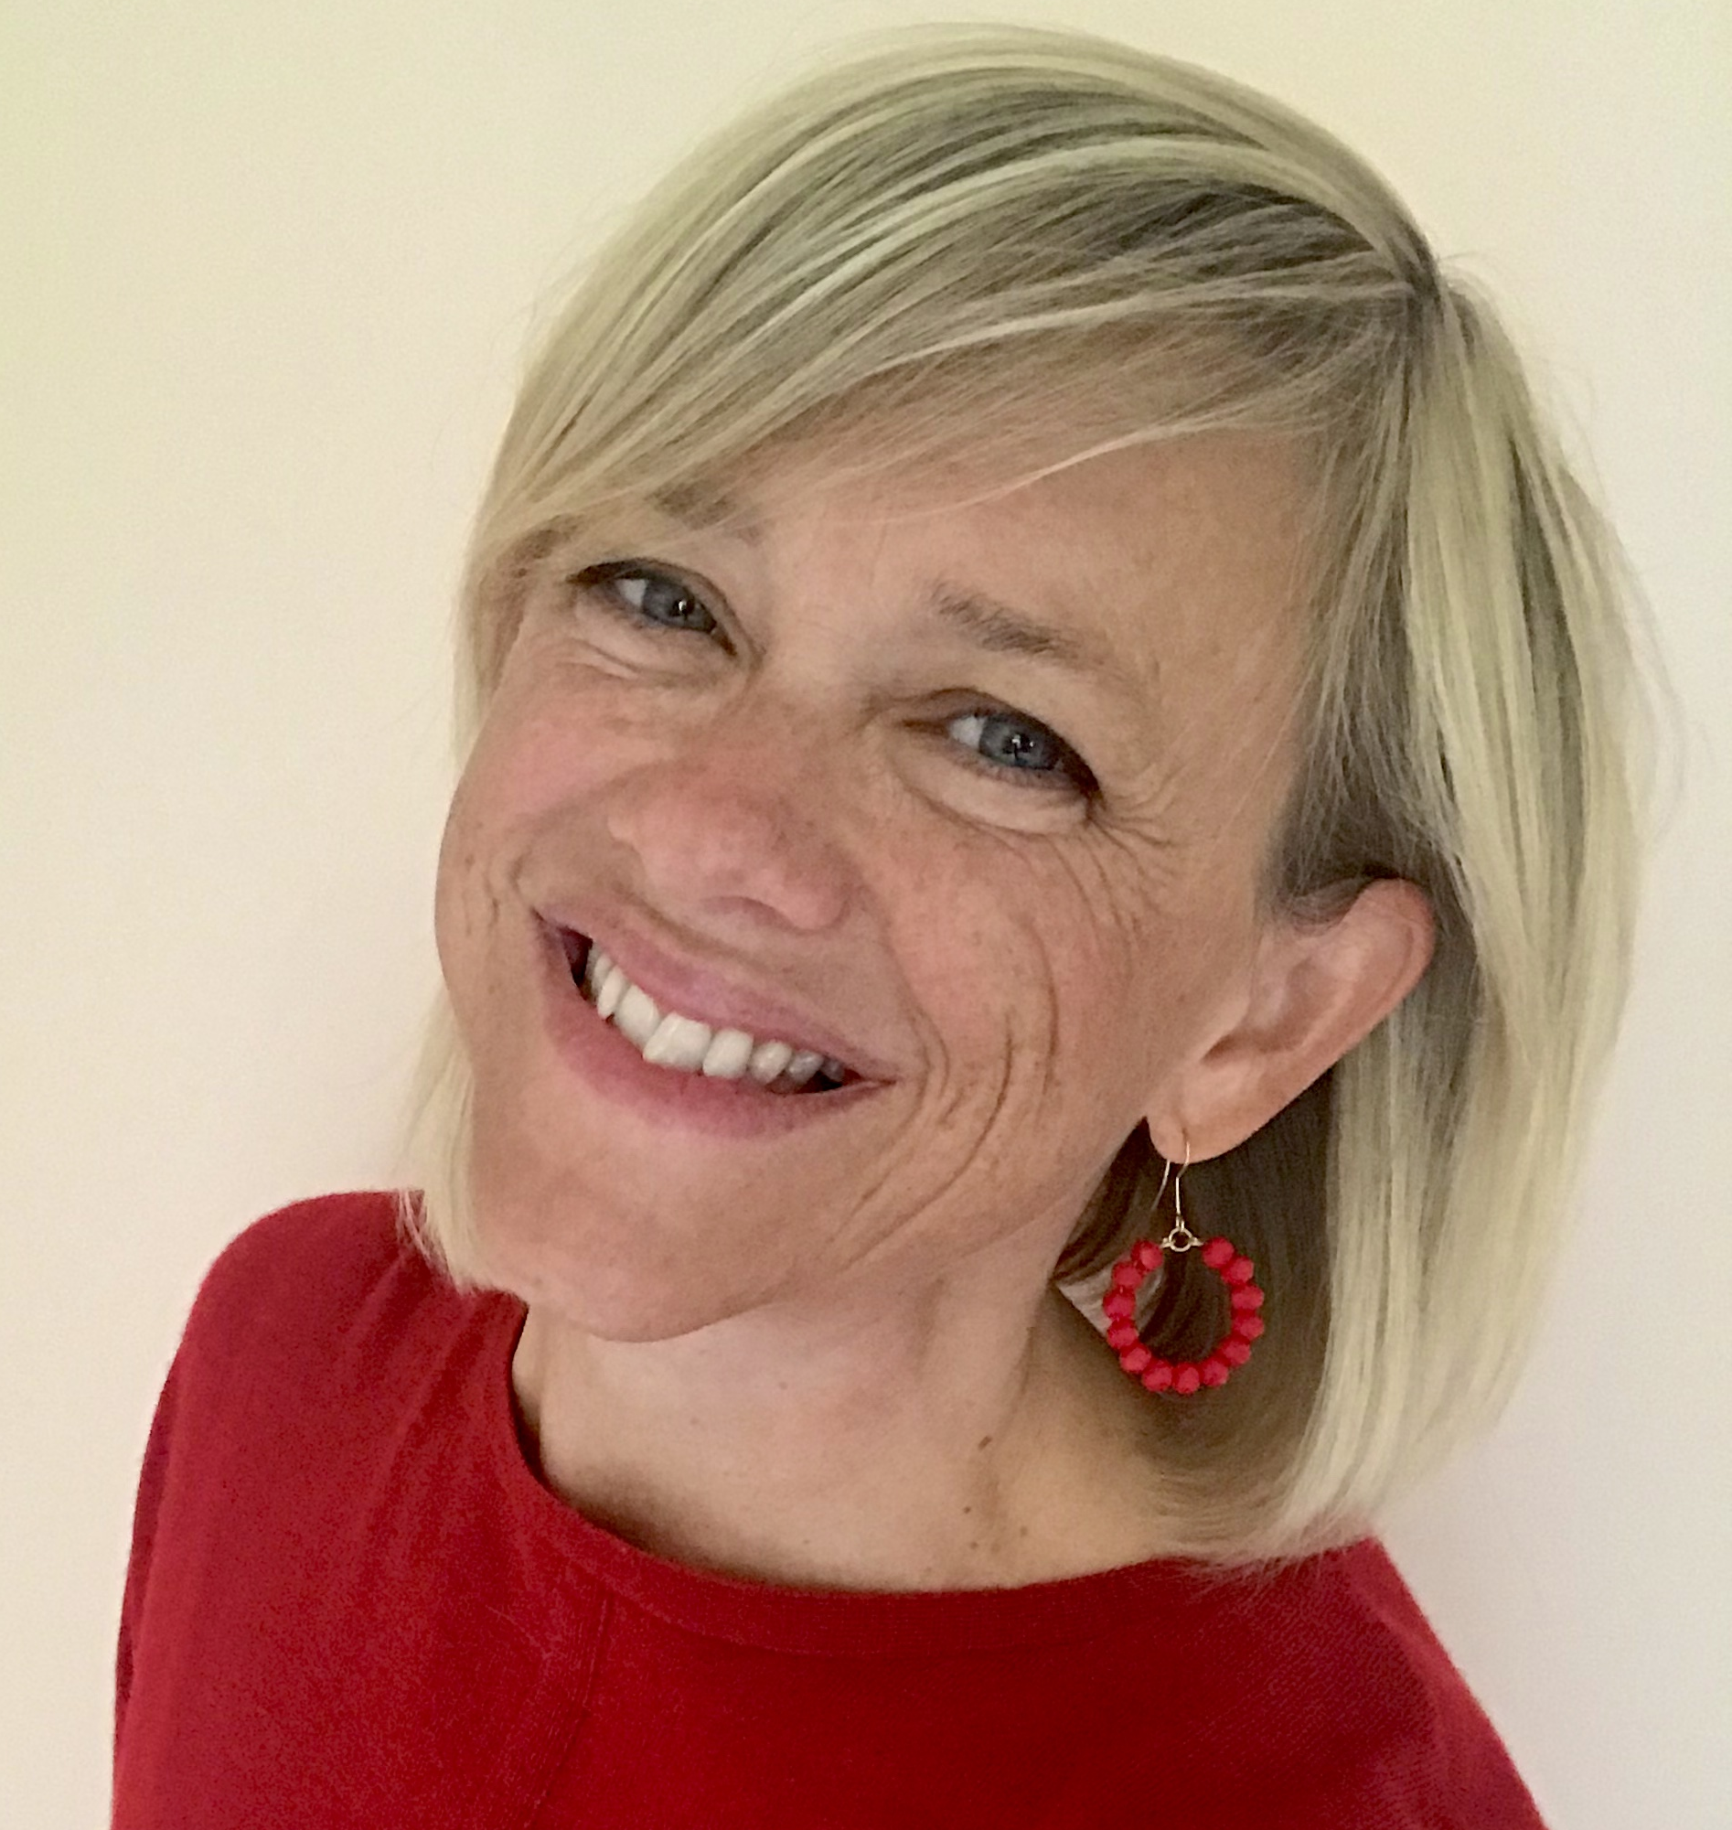
Lucy Ball
everywoman expert

Slide 5
Change-makers
Who are you trying to influence?
A team?
An individual?
An organisaton?
What are you trying to change?
An idea?
A process?
A policy?
A culture?
@everywomanUK

Slide 6
And what is it about YOU that is going to make that change more or less likely?
@everywomanUK

Slide 7
Use of self
YOUR YOU-NESS IS LEAKING!
@everywomanUK

Slide 8
PAST PRESENCE
PRESENT PRESENCE
FUTURE PRESENCE
@everywomanUK

Slide 9
PAST PRESENCE
Credentials and reputation
Work and life experience
Who you know
The things you have done and seen
PRESENT PRESENCE
FUTURE PRESENCE
@everywomanUK

Slide 10
PAST PRESENCE
Credentials and reputation
Work and life experience
Who you know
The things you have done and seen
Your identity
How you dress
Your posture, voice, tone
What you talk about and care about
How you interact with others
PRESENT PRESENCE
FUTURE PRESENCE
@everywomanUK

Slide 11
PAST PRESENCE
Credentials and reputation
Work and life experience
Who you know
The things you have done and seen
Your identity
How you dress
Your posture, voice, tone
What you talk about and care about
How you interact with others
What you teach people that they remember
Shifts that you create that have a lasting impact
The feelings that you leave people with
PRESENT PRESENCE
FUTURE PRESENCE
@everywomanUK

Slide 12
Change takes place at the intersection of what is the same and what is different.
@everywomanUK

Slide 13
The Perceived Weirdness Index
ABSORB
REJECT
Low
Perceived Weirdness
High
Perceived Weirdness
(J Hanafin, 1976)
@everywomanUK
Notes:
A note about WEIRD

Slide 14
The Perceived Weirdness Index
ABSORB
INFLUENCE
REJECT
Low
Perceived Weirdness
Perceived Weirdness
“Sweet Spot”
High
Perceived Weirdness
(J Hanafin, 1976)
@everywomanUK

Slide 15
Chat: Can you think of some examples?
@everywomanUK

Slide 16
Poll One: Tell us about you
Thinking of a specific setting…
:
A - I am perceived as too weird
B - I am in the ‘sweet spot’
C - I am perceived as not weird
D - I don’t know
@everywomanUK
Notes:
Let’s do a quick poll

Slide 17
Just enough fitting in
In what ways are you already similar to your stakeholders?
In what ways do you seek to fit in?
How do you join with people?
@everywomanUK

Slide 18
Just enough standing out
In what ways do you dare to be different?
What do you take a stand on?
What’s your truth and do you speak it?
@everywomanUK

Slide 19
Key messages
To influence others you need to be ‘just weird enough’.
Embrace your you-ness.
Keep learning about your impact on others.
Be intentional about the balance between fitting in and standing out.
@everywomanUK

Slide 20
Questions?

Slide 21
Dates for your diary
Date | Time (BST) | Topic
24th August | 14.00 | Creating a culture in a hybrid working world
1st September | 14.00 | Good grief: Coping with bereavement, disappointment, and loss
6th September | 11.00 | How to fit more self-care into your life
16th September | 10.30 | How to improve your speaking voice
21st September | 15.00 | Resilience top-ups: Power practices for everyday focus and wellbeing
28th September | 12.30 | What comes after uncovering your unconscious biases?
@everywomanUK

