Slide 1
SelfMade Entrepreneurs Hub
Getting the Journalist to cover your messages and not theirs.
Five top tips
Peter Ibbetson
JournoLink
@JournoLink

Slide 2
Head of Event Operations
Katie Trice
katie@everywoman.com

Slide 3
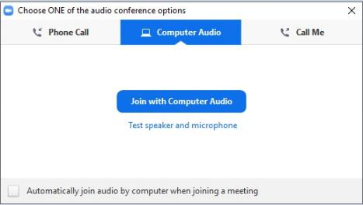
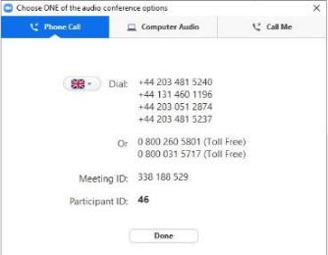
Dialling in
You will not need a microphone
To use headphones:
click ‘Call Using Computer’
To dial in and listen via phone:
CLICK ‘Phone Call’
and follow the instructions on screen

Slide 4
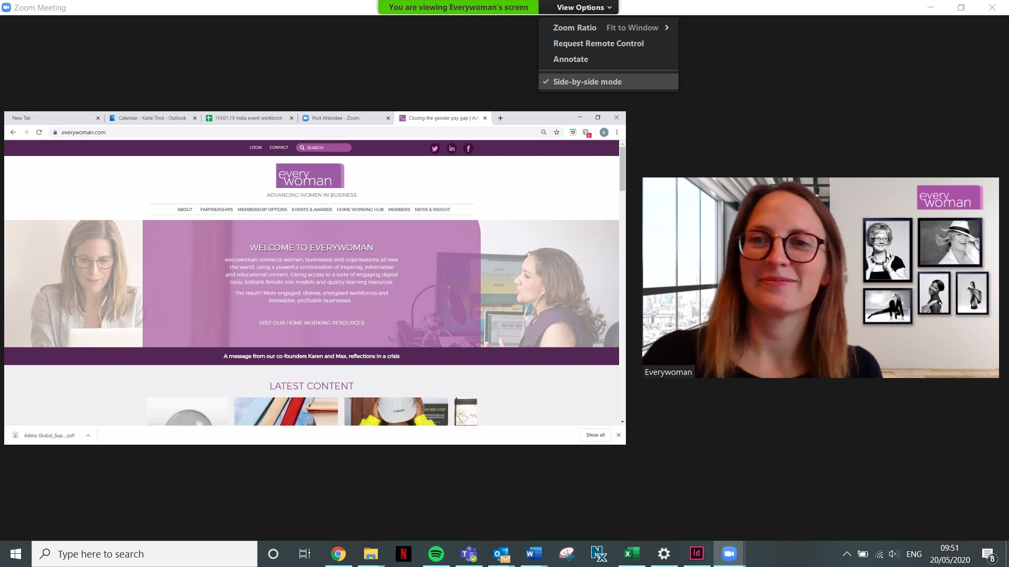
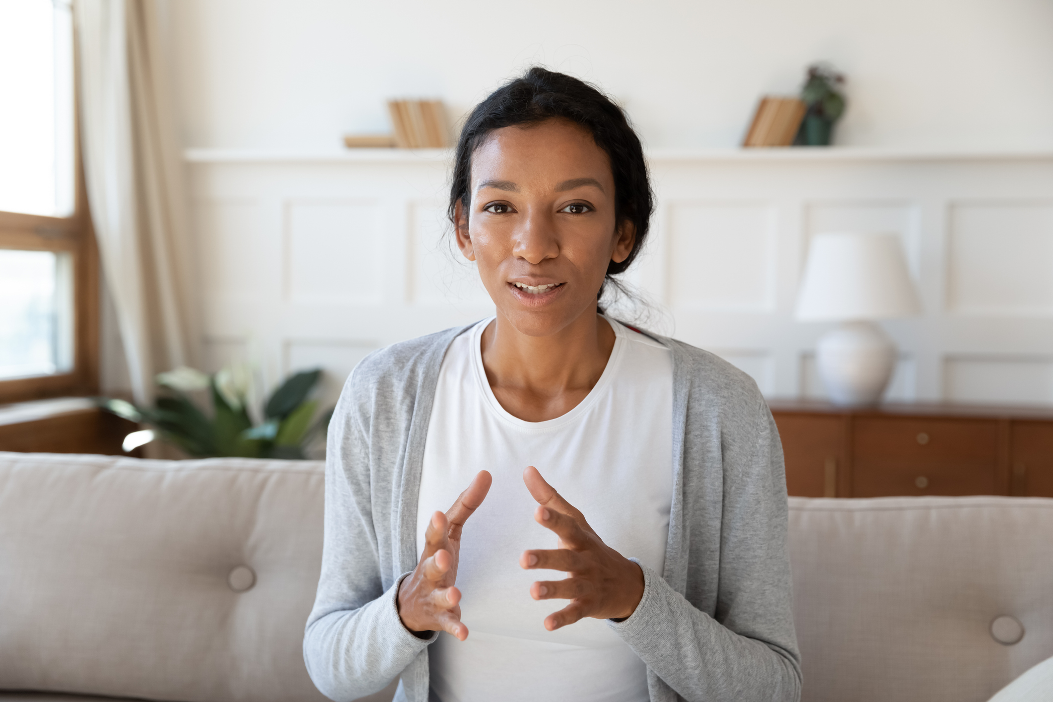

Slide 5
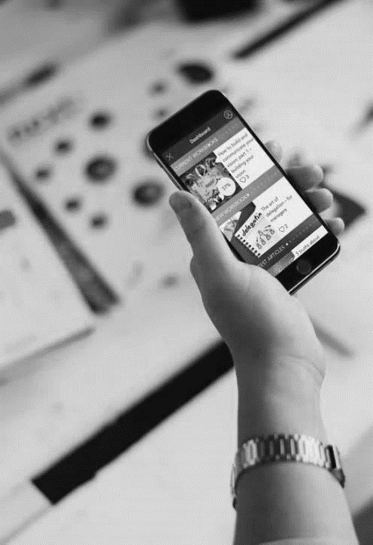
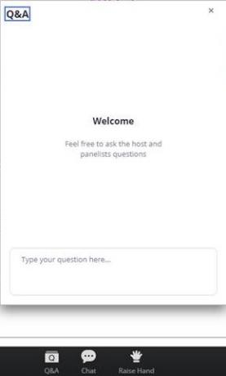
Questions
Send a question

Slide 6
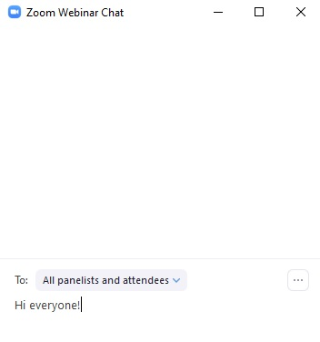
Let’s get chatting
using the chat function

Slide 7
JOIN THE EVERYWOMAN SELFMADE COMMUNITY
be part of the conversation
@EverywomanLTD
@ewSelfMade
@ewselfmade
#ewSelfMade
www.everywoman-selfmade.com

Slide 8
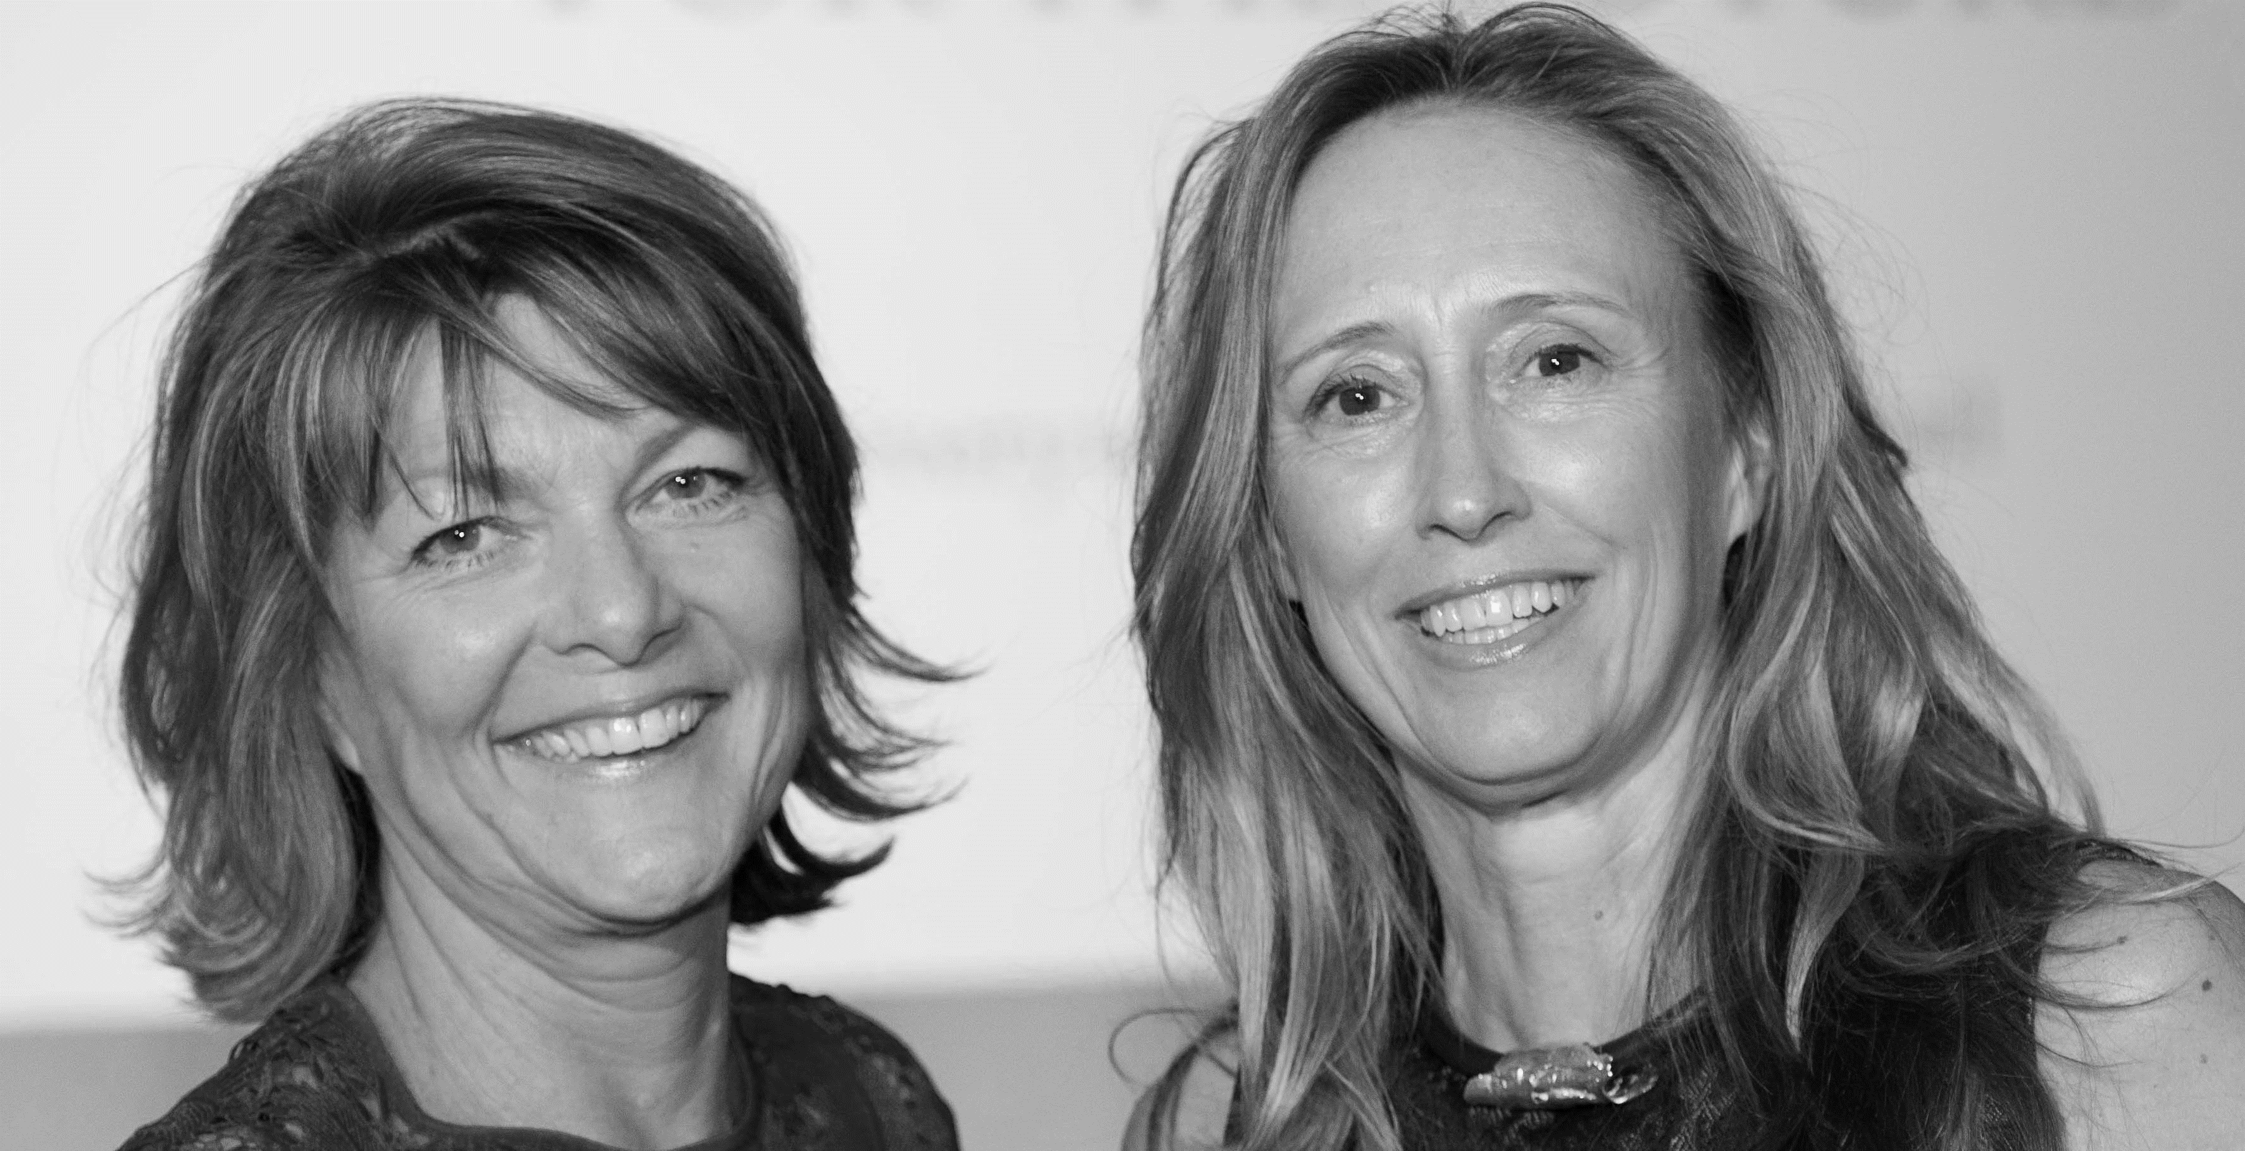
Karen Gill MBE
Co-Founder, everywoman
Maxine Benson MBE
Co-Founder, everywoman
Notes:
Slide with K & M picture

Slide 9
Notes:
Tech poster here

Slide 10
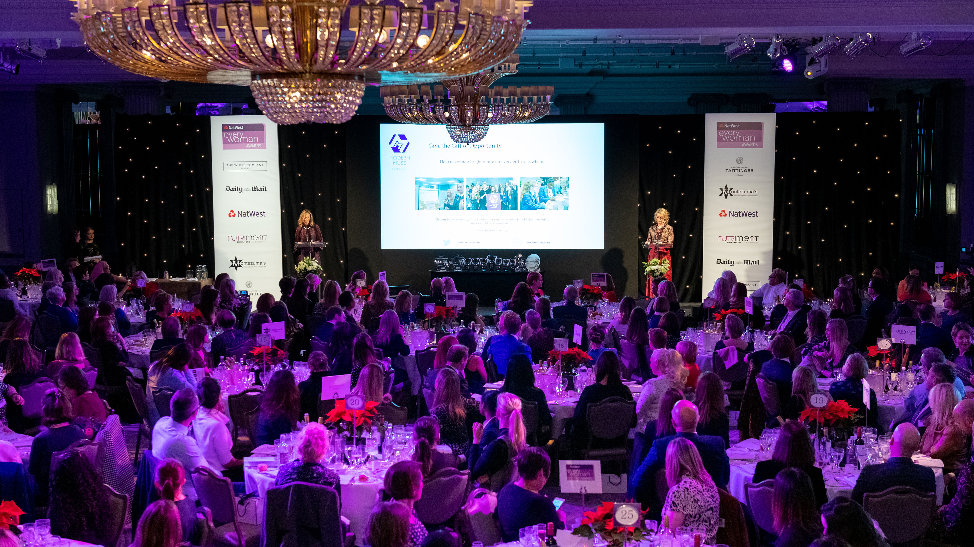
2020 NatWest everywoman Awards 2 December, The Londoner, Leicester Square
Nominations Open: everywoman.com/ewAwards

Slide 11
SelfMade Entrepreneurs Hub
Top five must do's in handling the journalists
Peter Ibbetson
JournoLink
@JournoLink

Slide 12
SelfMade Entrepreneurs Hub PR Support
www.everywoman-selfmade.com/journolink

Slide 13
Getting the Journalist to cover your messages and not theirs. Five top tips
Peter Ibbetson
JournoLink working with everywoman
www.journolink.com

Slide 14
Tip 1. Control
This is your gig.
Without you the journalist has an empty programme
You own the time. You own the messages
You are the journalist’s pimp
Without good broadcast there is no journalist
Help the journalist get good broadcast……with your messages
Without the journalist you have no platform

Slide 15
Tip 2. It’s all about the Prep
Objective
This is real, not just an ego trip
Your audience
Their heads, their expectations and their perceptions
Your target messages
Maximum three clear issues to land
The bear traps
Perfect your close down pushbacks

Slide 16
Tip 3. The two no no’s
The First Question
You don’t need to ask what it will be
You already know the answer
Avoid Q&A’s
The words you use in a response have to be yours
‘Scripted answers’ lack authenticity
And they won’t roll off your tongue

Slide 17
Tip 4. The Delivery
First Answer
Deflect to your agenda setting
The Detail
Fill out the detail as you go
Land your quotes and avoid the traps
The Closing
Reinforce your three points
This is what will impact

Slide 18
Tip 5. It’s still on Mr Brown
Print
Nothing is off the record
Radio
The microphone is always on
TV
The camera is always on
…….....even if you think it’s not!!

Slide 19
Find out more and sign up:
https://www.everywoman-selfmade.com/journolink
Follow us :
Twitter @JournoLink
Linkedin @JournoLink
Facebook @JournoLink.pr
Instagram @JournoLink
www.journolink.com

Slide 20
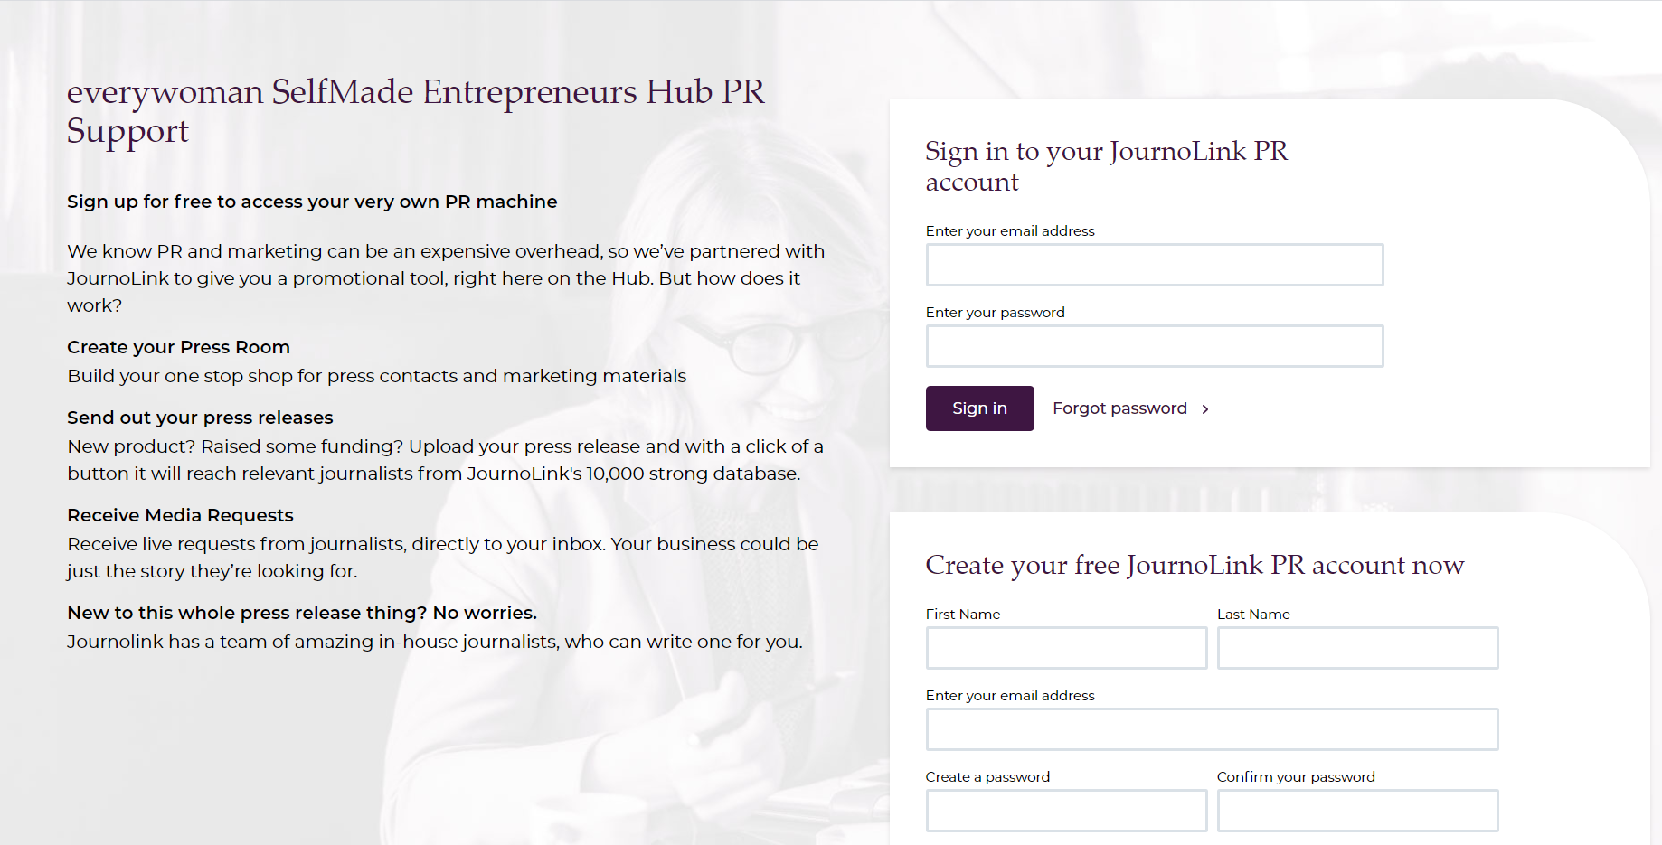
www.everywoman-selfmade.com/journolink

Slide 21
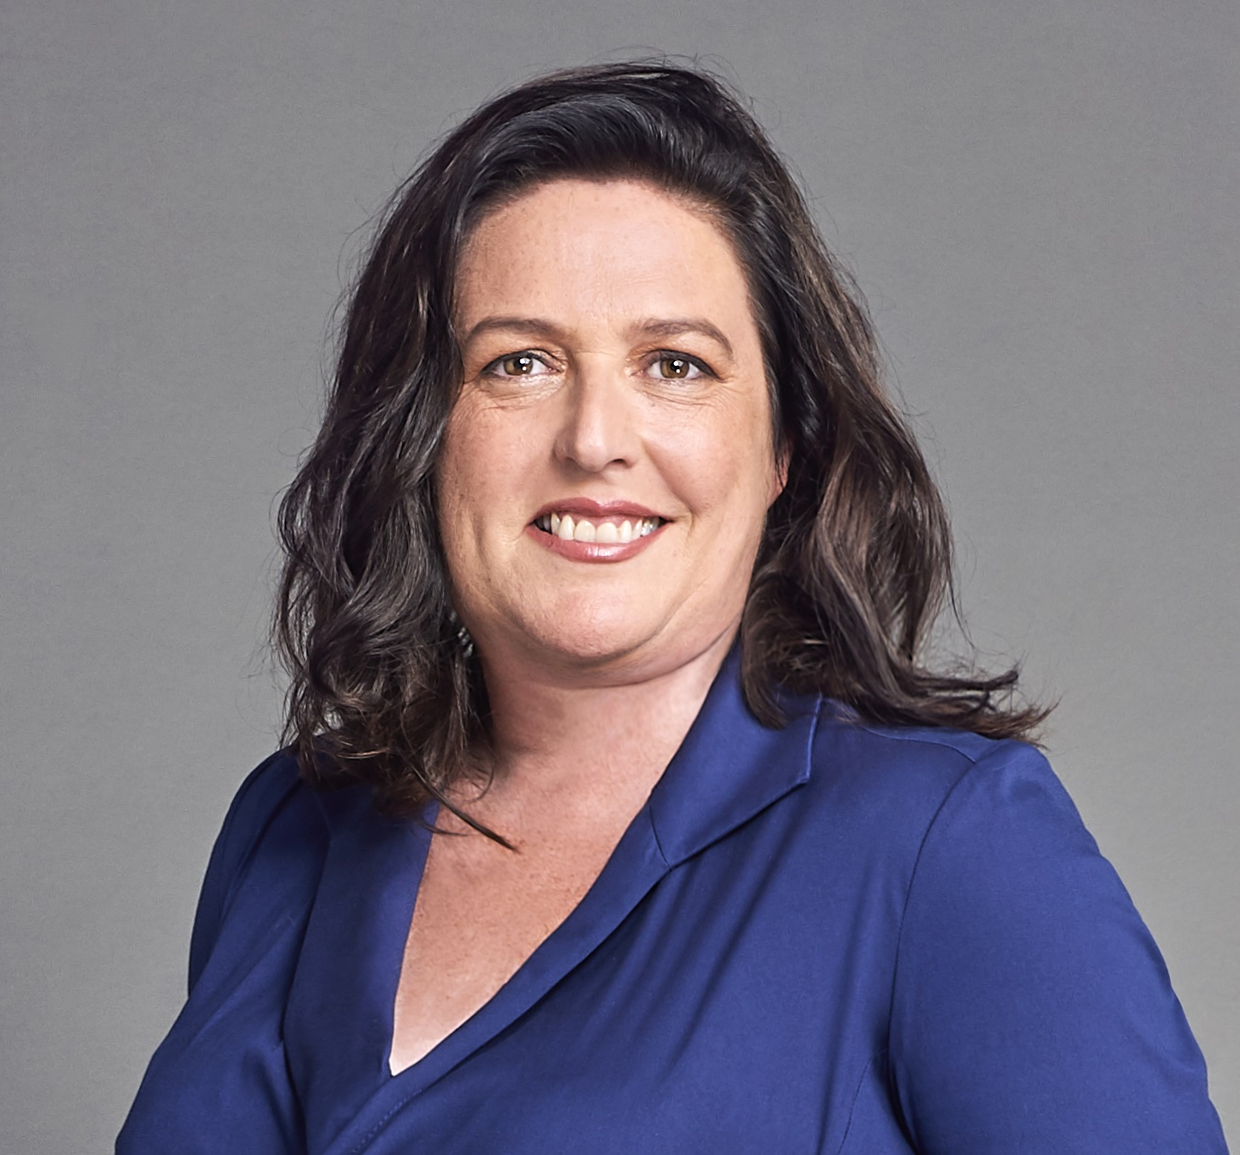
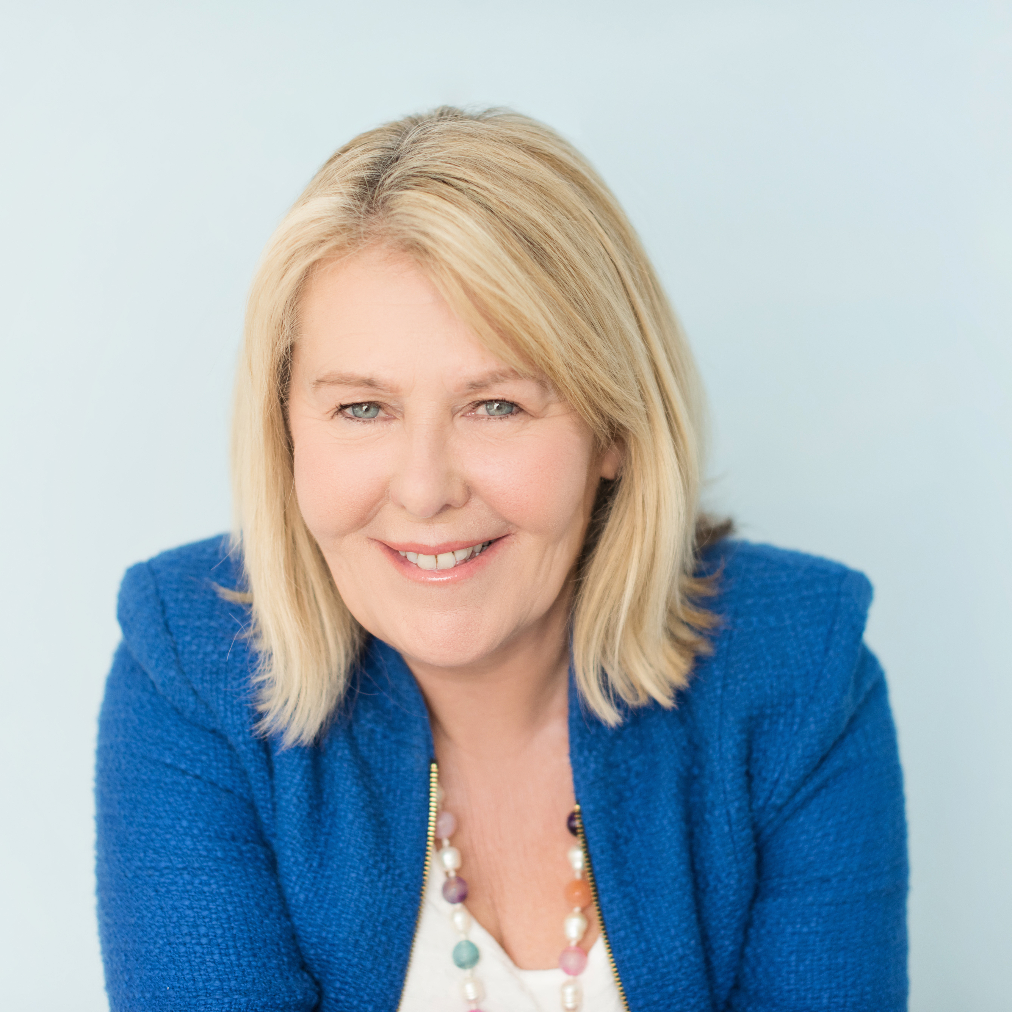
Dates for your diary
Date & Time | Virtual Event
17 June 10.30 BST | The three PR mindsets Tetteh Kofi
24 June 14.00 BST | Suzanne Brock, Founder, Nutriment
22 July 14.00 BST | Susan Ann Hills, Founder, Zenith Women and Managing Director, MyCare Services Ltd

Slide 22
FREE WEBINARS
everywoman.com/home-working-hub

Slide 23
#ewSelfMade
everywoman everywhere

