Slide 1
SelfMade Entrepreneurs Hub
Top five tips to get your PR in front of the journalists
Tetteh Kofi
Journalist
@TetKofi

Slide 2
Head of Event Operations
Katie Trice
katie@everywoman.com

Slide 3
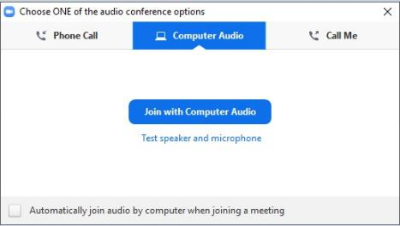
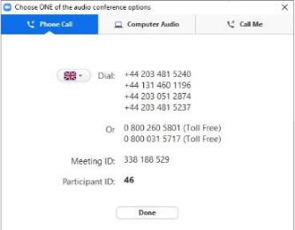
Dialling in
You will not need a microphone
To use headphones:
click ‘Call Using Computer’
To dial in and listen via phone:
CLICK ‘Phone Call’
and follow the instructions on screen

Slide 4
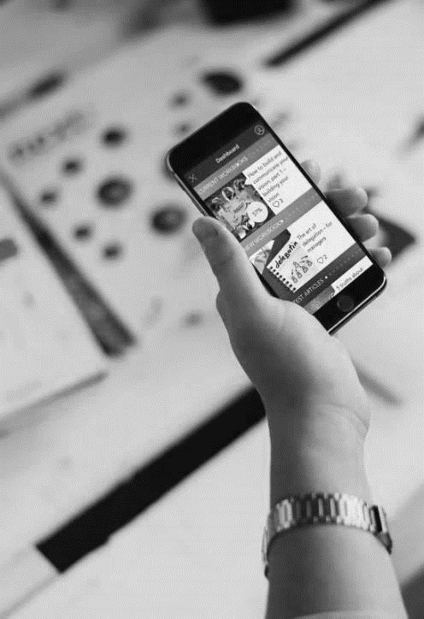
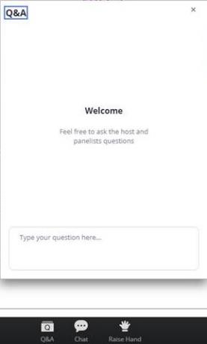
Questions
Send a question

Slide 5
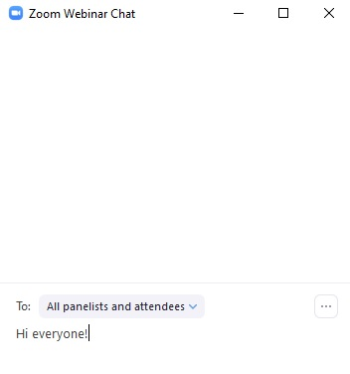
Let’s get chatting
using the chat function

Slide 6
JOIN THE EVERYWOMAN COMMUNITY
be part of the conversation
@EverywomanLTD
@everywomanUK
@everywomanUK
@everywomanUK
#ewSelfMade

Slide 7
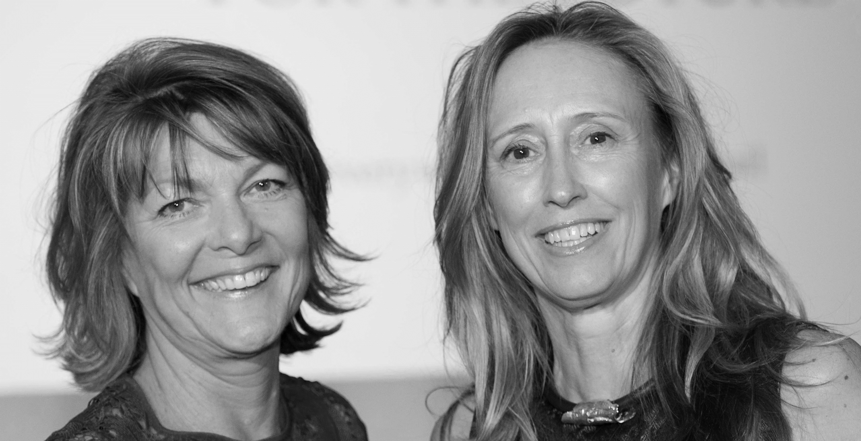
Karen Gill MBE
Co-Founder, everywoman
Maxine Benson MBE
Co-Founder, everywoman
Notes:
Slide with K & M picture

Slide 8
Notes:
Tech poster here

Slide 9
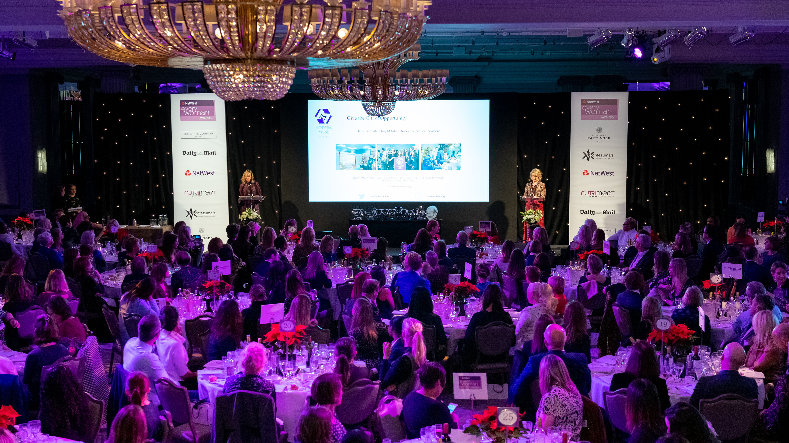
2020 NatWest everywoman Awards 2 December, The Londoner, Leicester Square
Nominations Open: everywoman.com/ewAwards

Slide 10
Maxine Benson MBE
Co-Founder
Everywoman Ltd

Slide 11
SelfMade Entrepreneurs Hub PR Support

Slide 12
SelfMade Entrepreneurs Hub
Top five tips to get your PR in front of the journalists
Tetteh Kofi
Journalist
@TetKofi

Slide 13
5 tips for getting the attention of Journalists
A presentation for Everywoman
By Tet Kofi
Journolink

Slide 14
Define your Story Type
Product Placement
Niche Media
Digital Influencers
Bloggers , Social & Web
News Item
MSM , Print, Online
Niche Media,
Social & Web
Feature Story
MSM , Print, Online
Digital Influencers
Podcasters Social & Web

Slide 15
Be Topical
Apply Social Listening
Identify the News Agenda for your sector
The news Agenda Defines shareability
Timing is crucial
PR Planning
Story Generation

Slide 16
Be sure to have News Merit
Pass the “So What” “No Yawns” Test
Is there a Threat?
Does it Inspire?
Fulfill a significant Lack?
Has it been endorsed by peers?
Sources of Stories
Company structure
Team Staff Founders
Daily Ops
Your offering – Value prosoition
Customers

Slide 17
Press Releases should give facts not sell
A big idea reflected in the headline
Never more than 800 words , I prefer 400.
Answer the questions Kipling's servants asked 5 “W”s 1 “H”
What
Where
When
Who
Why
How
Quotes
Pictures
Sources

Slide 18
Press Pitches
Timing varies by outlet type
Magazine 3-6mths
Papers 1 day , 1-3 weeks
Influencers 1-2 months
Podcasters2-6 weeks
Radio & TV 1-2 days
Content
Be relevant to the journalist and outlet

Slide 19
Questions
Send a question

Slide 20
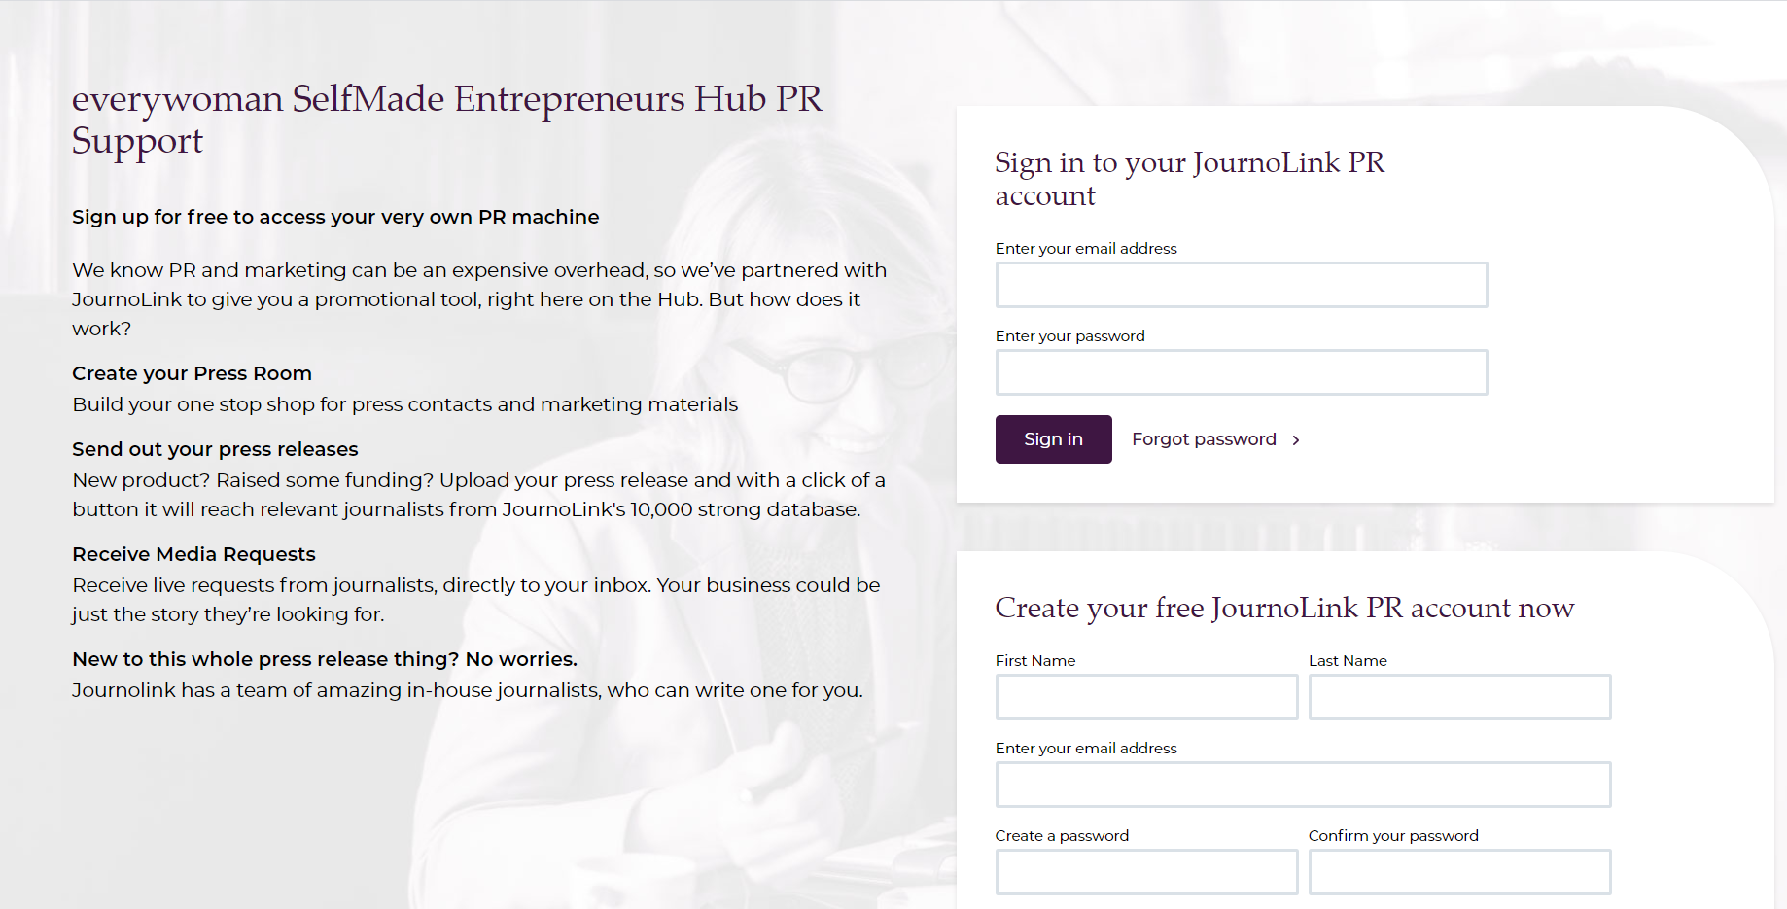
www.everywoman-selfmade.com

Slide 21
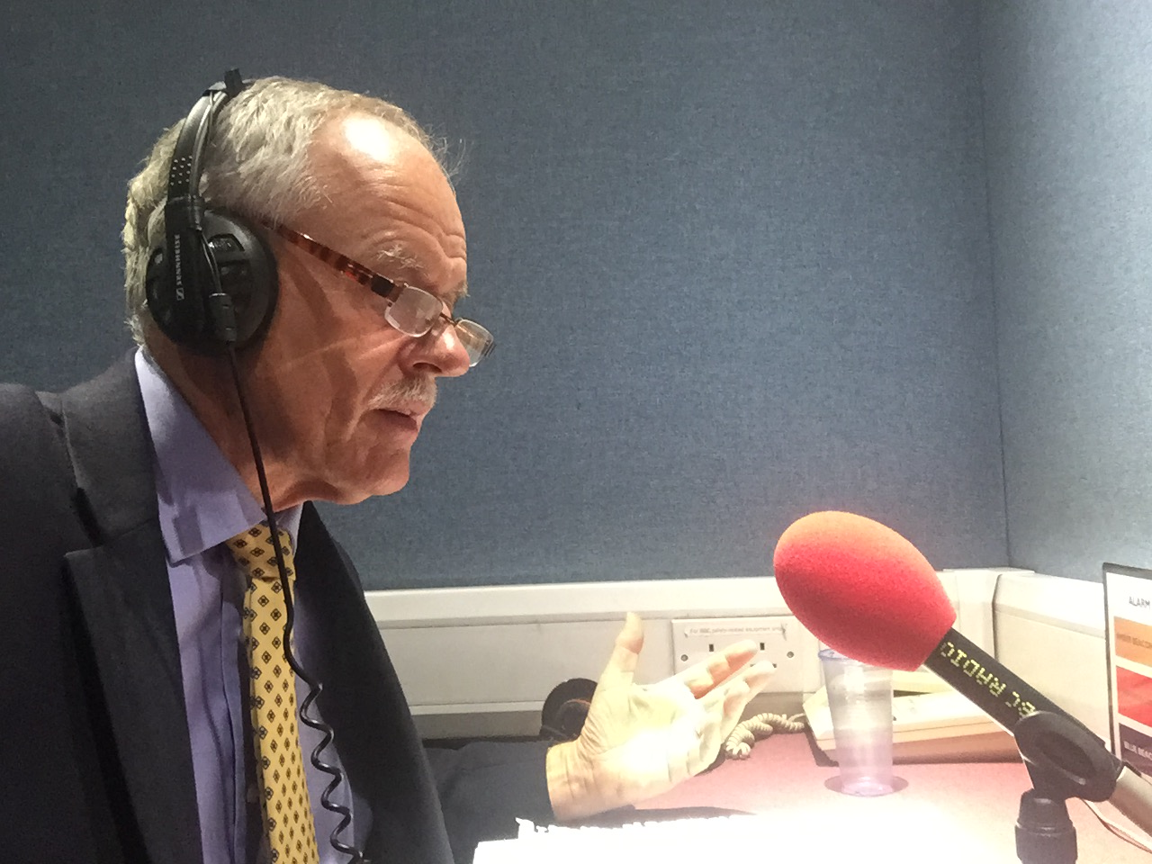
Dates for your diary
Date & Time | Virtual Event
27 May 10.30 BST | Top five must do's in handling the journalists Peter Ibbetson
17 June 10.30 BST | The three PR mindsets Tetteh Kofi

Slide 22
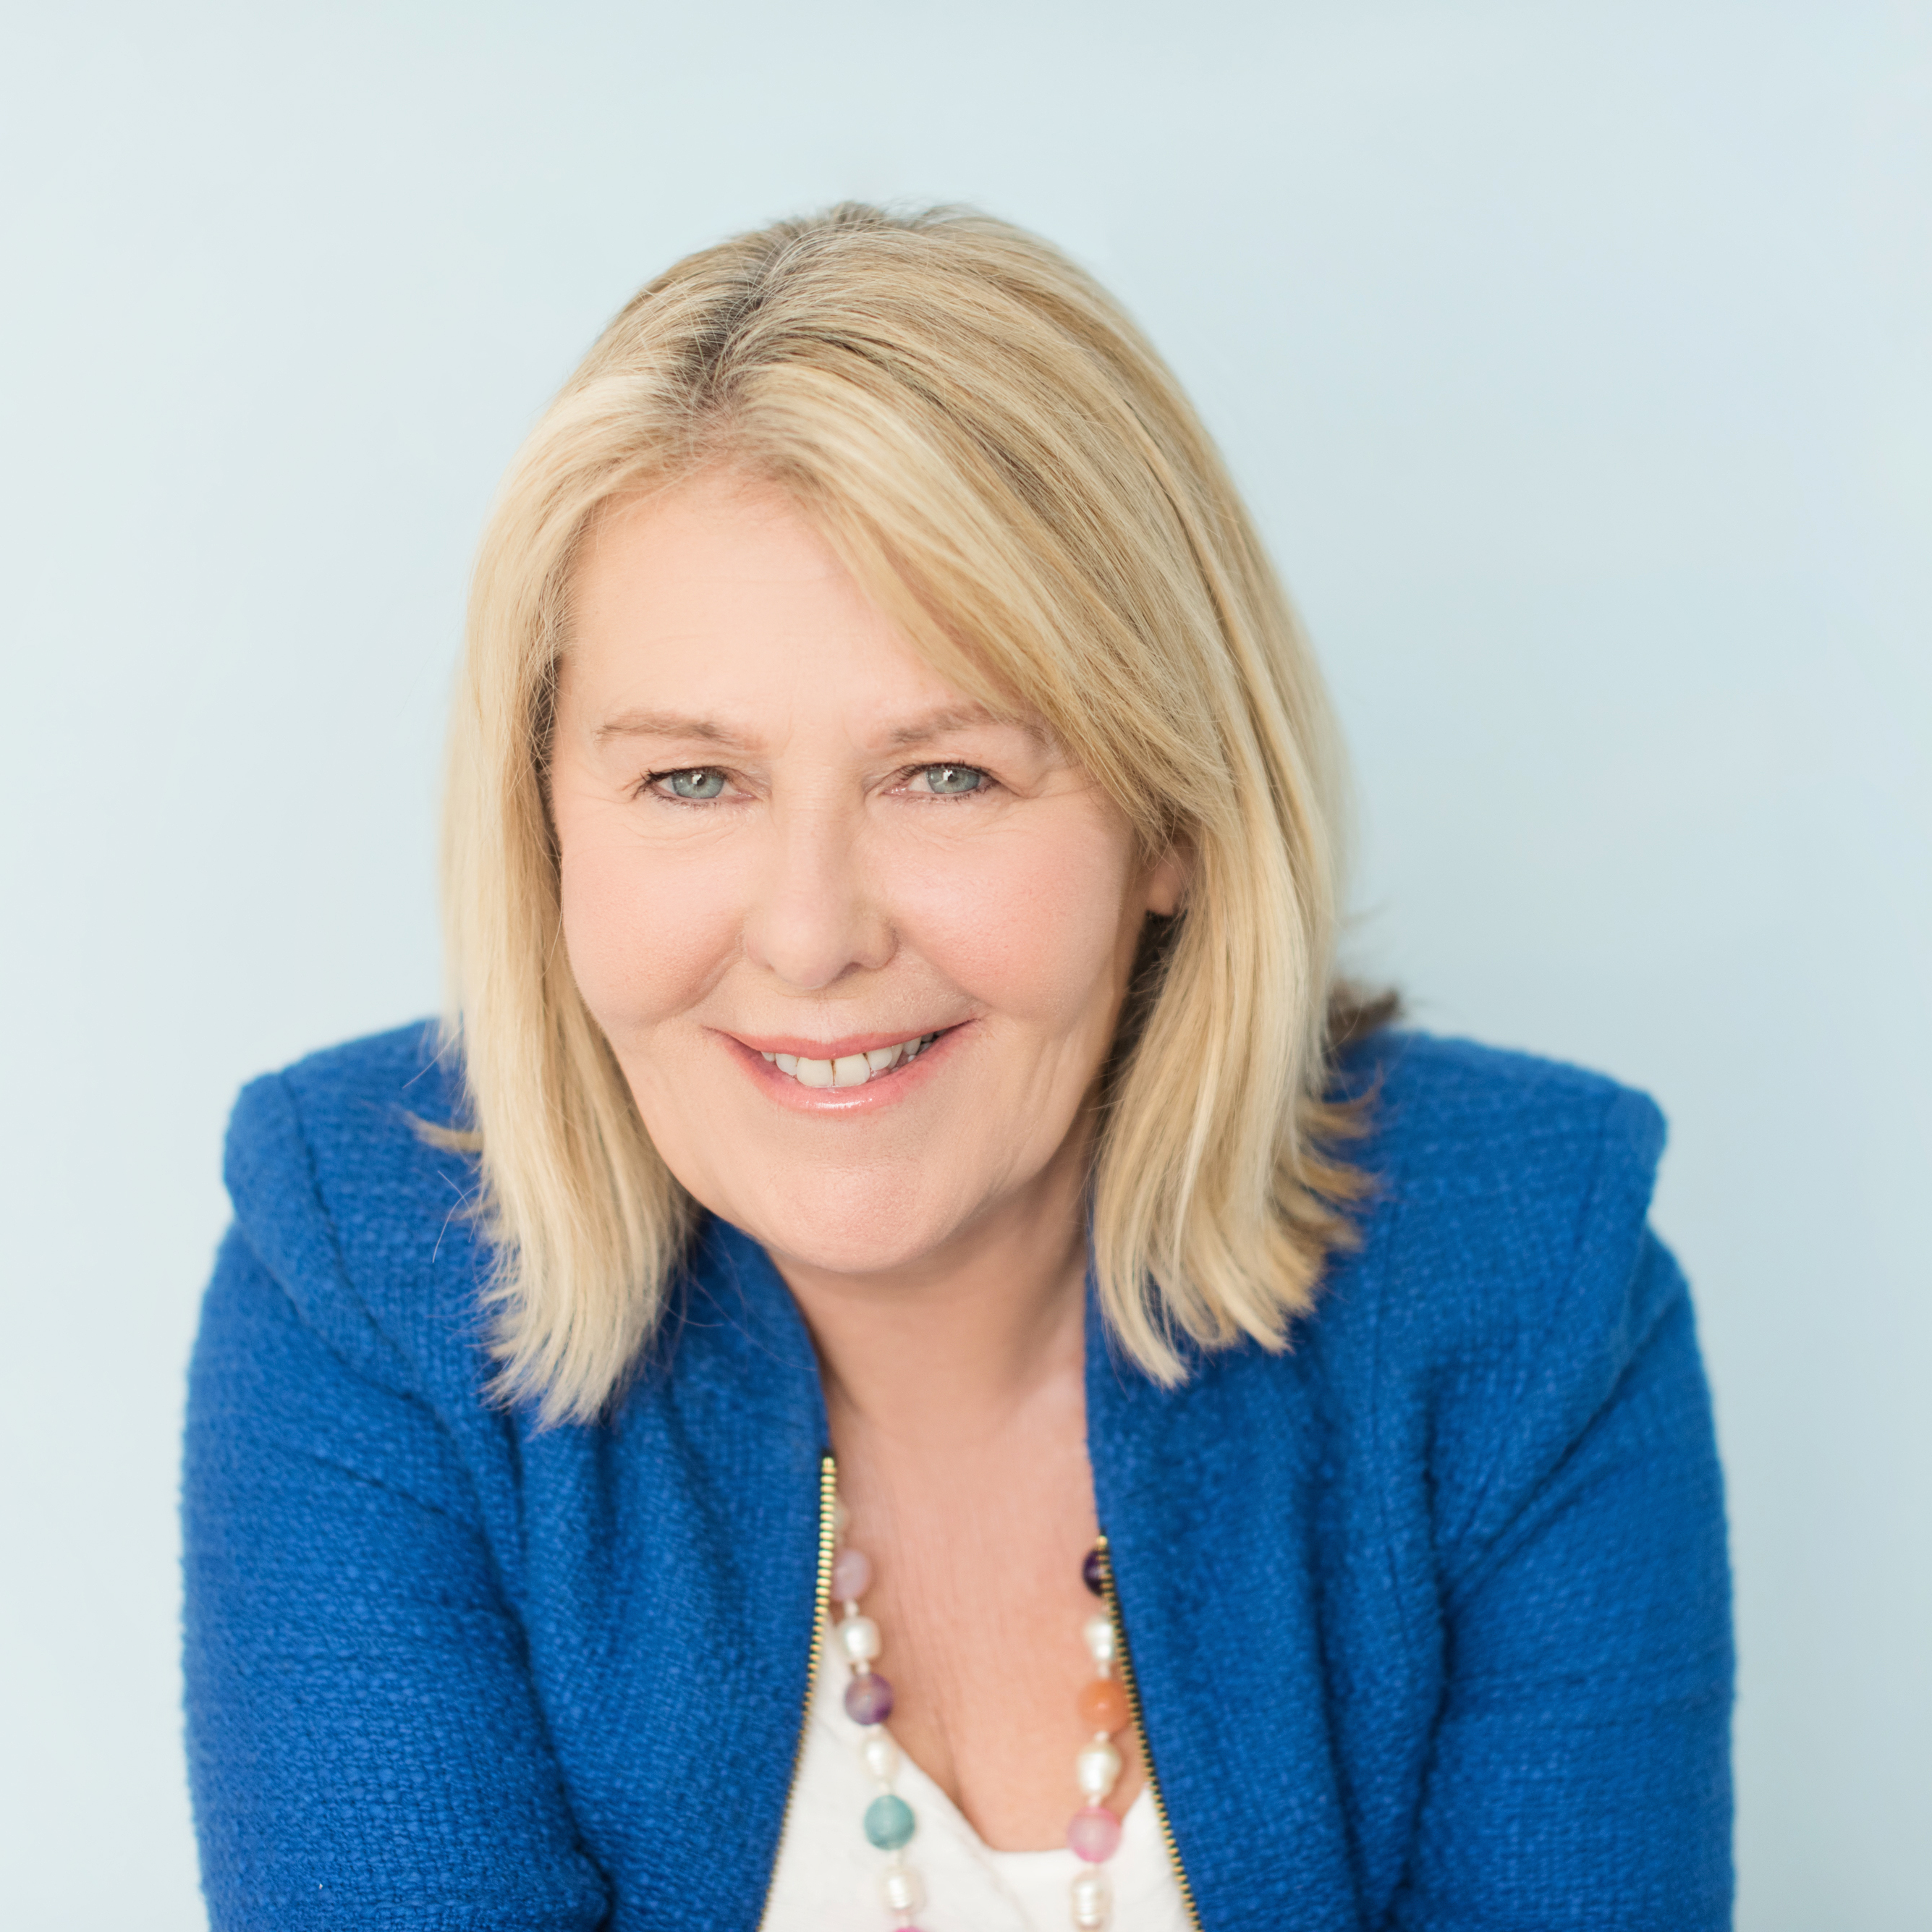
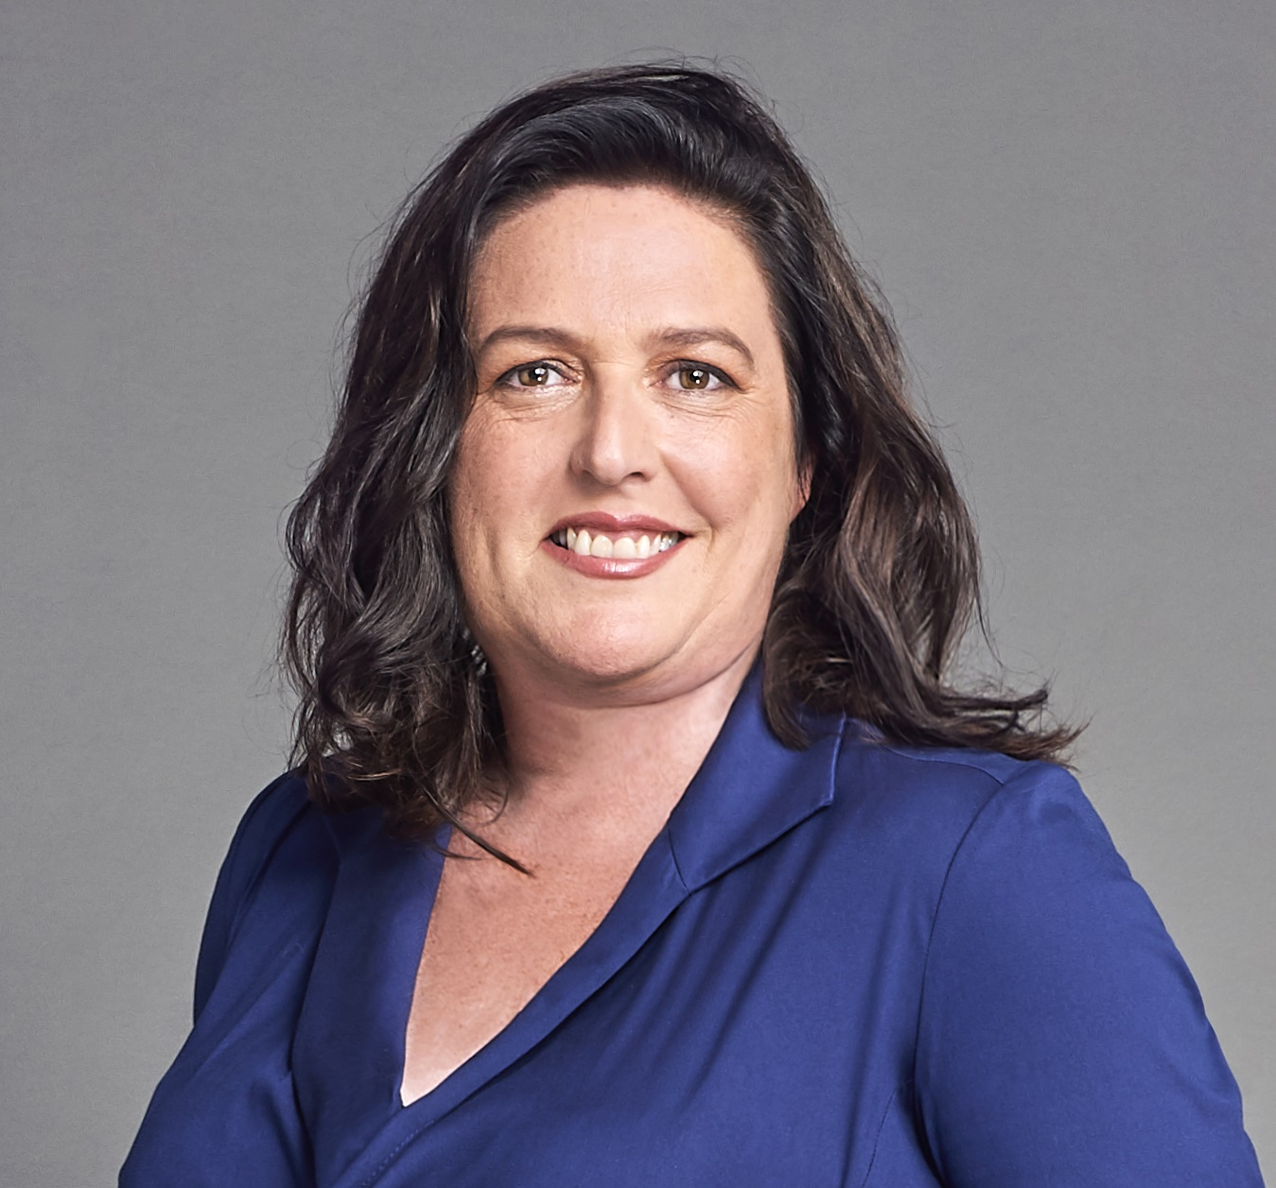
Dates for your diary
Date & Time | Virtual Event
13 May 14.00 BST | Annoushka Ducas MBE, Founder, Annoushka
20 May 14.00 BST | Roni Savage, Founder, Jomas Associates
3 June 14.00 BST | Susan Ann Hills, Founder, Zenith Women and Managing Director, MyCare Services Ltd
24 June 14.00 BST | Suzanne Brock, Founder, Nutriment

Slide 23
#ewSelfMade
everywoman everywhere

